Slide 1
TASK 2

Slide 2
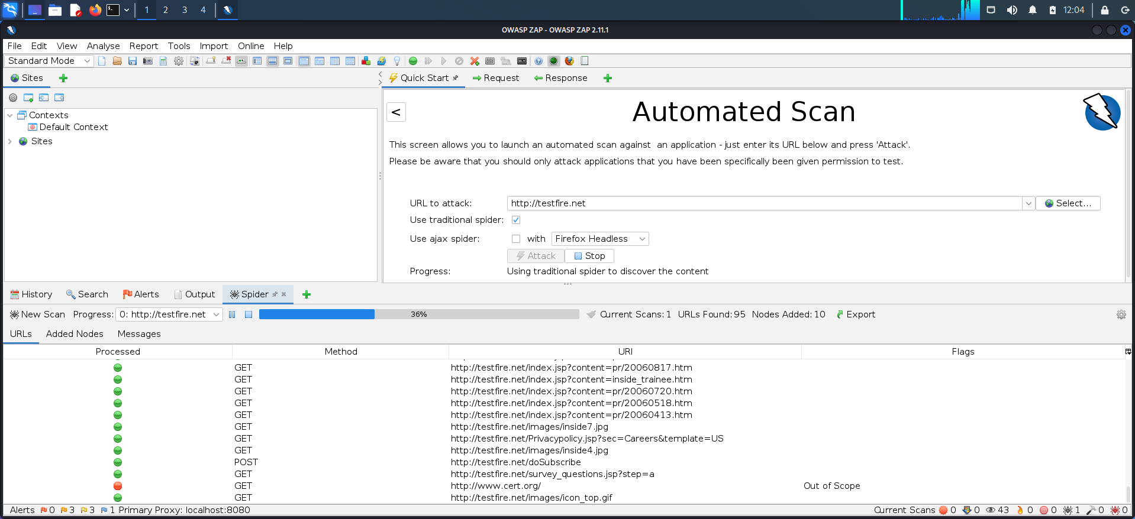

Slide 3
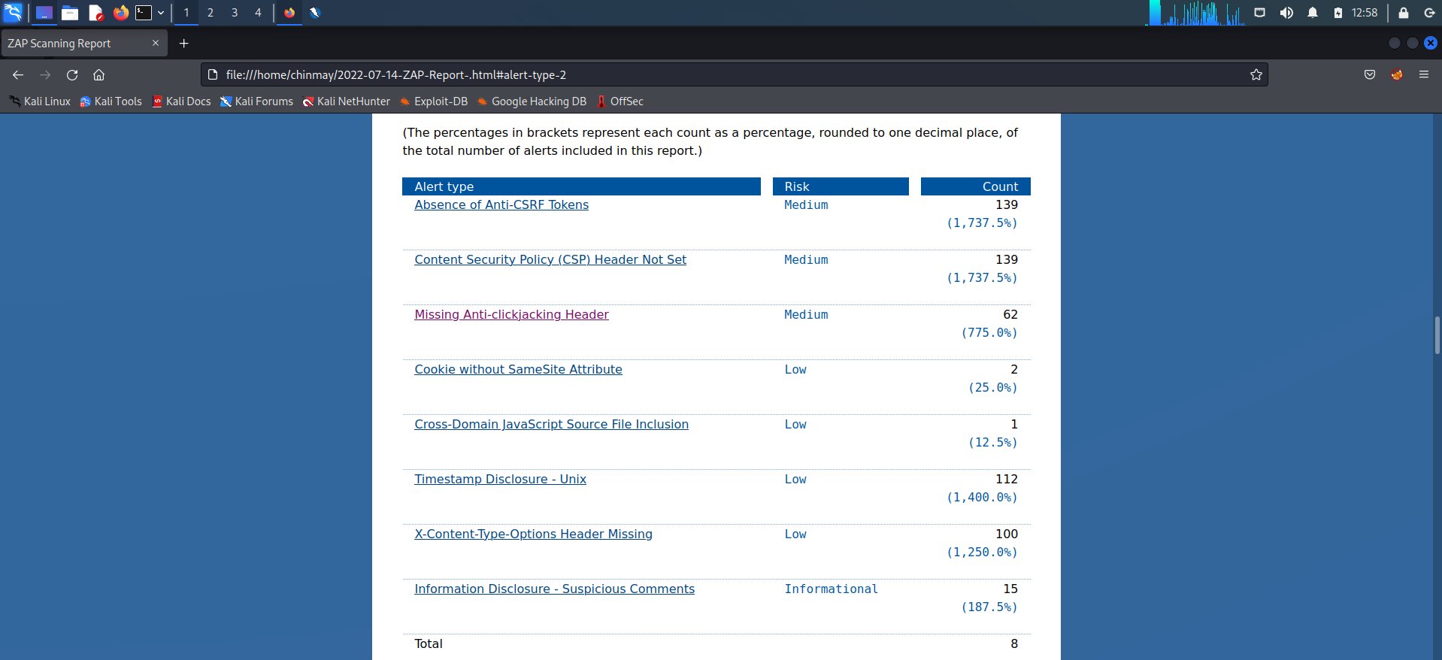

Slide 4
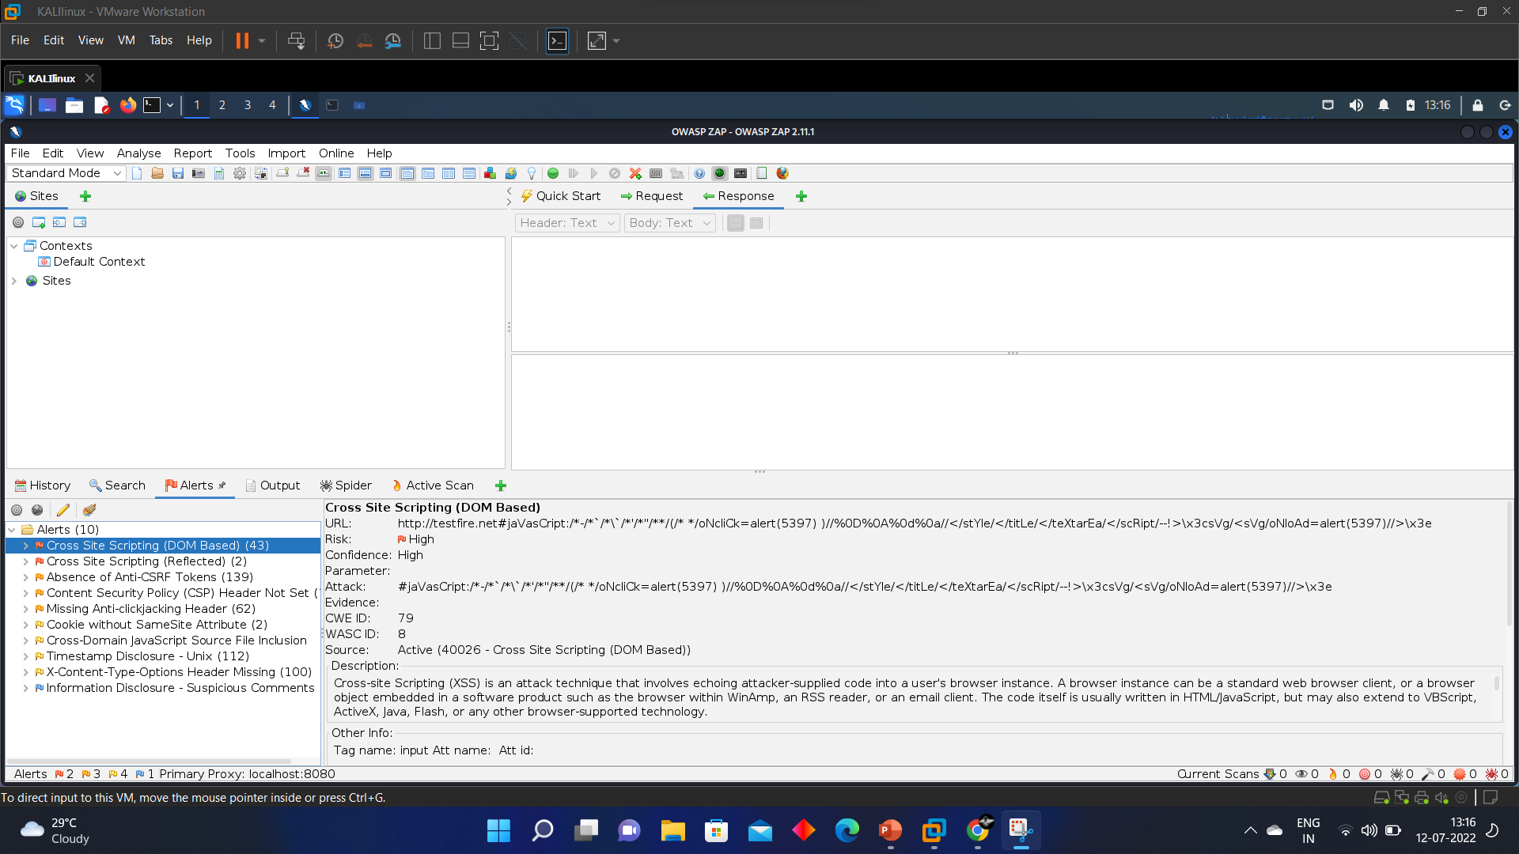

Slide 5
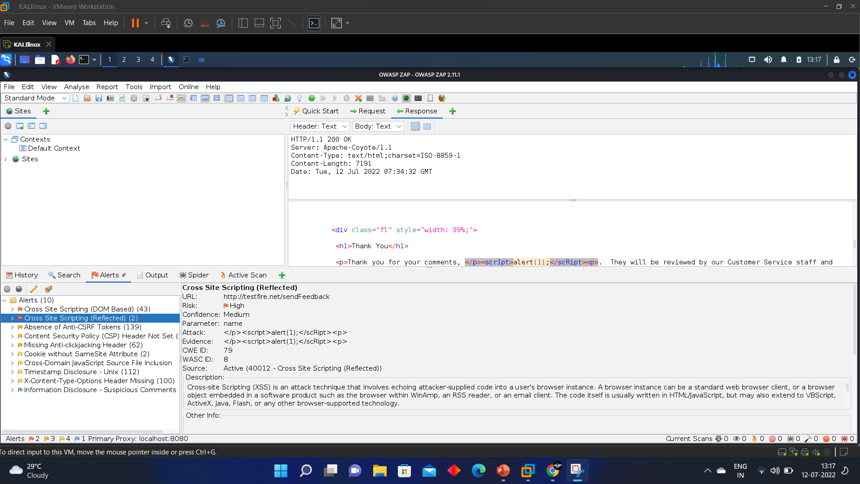

Slide 6
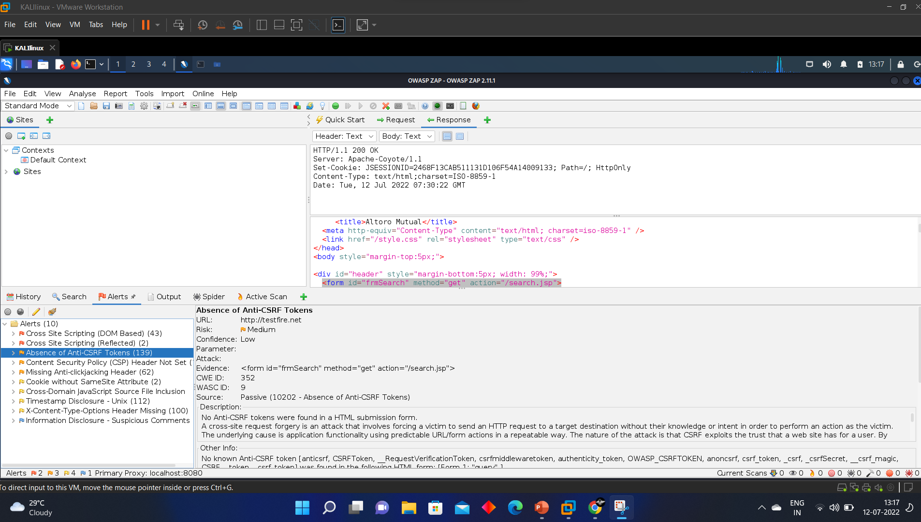

Slide 7
Low level threat
Title – absence of anti CRSF tokes
Description - A HTML submission form included no Anti-CSRF tokens.In a cross-site request forgery attack, a victim is coerced into sending an HTTP request to a target location without their knowledge or consent so that the attacker can act in place of the victim. The root reason is application functionality employing recurring, predictable URL/form operations. The attack's nature is that CSRF takes advantage of the user's confidence in a website.

Slide 8
Medium level threat
Title – cross site scripting reflected
Description – the website was found vulnerable to cross site scripting with the script <script>alert(1)</script>. The attack method known as cross-site scripting (XSS) involves injecting attacker-provided code into a user's browser instance. An embedded browser object, such as the one found in WinAmp, an RSS reader, or an email client, can be used as a browser instance in addition to a normal web browser client. Typically, the code is written in HTML/JavaScript, but it may also use VBScript, ActiveX, Java, Flash, or any other browser-supported technology.

Slide 9
High level threat
Title – cross site scripting DOM based
Description –
url -http://testfire.net#jaVascript:/-////////oNclick-alert(5397) 1//
//</style/</title/</textarEa/</script/->\x3csvg/<svg NoAd-alert(5397)/> High
Attack -#javascript://pppp/oNclick=alert(5397) //
//</stYle/</title/</textarEa/</script/->\x3esvg/<svg/oNoAd-alert(53971//xle

